Slide 1
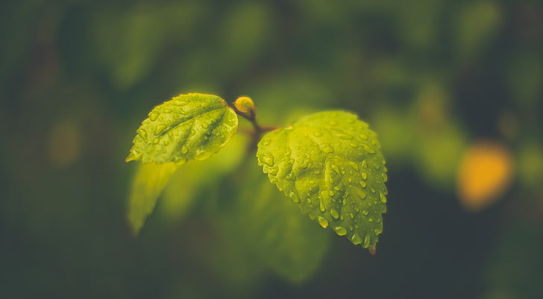
IoT Empowered Garden Watering System
Our primary goal is to make life easier by automating the day-to-day things in our lives.
Gardening is beautiful but daily watering is a bit boring and forgettable.
Therefore, we make things easier by creating an automated garden watering system based on IoT.
Depending on the prevailing weather conditions, the system will automatically water the garden twice a day.
If we want, we can water the garden even by manually through this system.
The main thing is that we can access and control it from anywhere via our mobile phone at any time.
Next slide will give you the overall structure of the system.

Slide 2
System
Auto Mode
Manual Mode
Get the garden location from the website
A website controller allows the user to water the garden at any time of the day
Send location data to the Node-RED
After watering, the NodeMCU goes into deep sleep mode for an hour
Get the weather condition of the location via OpenWeatherMap and send it to NodeMCU
NodeMCU wakes up and returns to the initial stage
Watering the garden twice a day according to the prevailing weather conditions
After watering, the NodeMCU goes into deep sleep mode according to a pre-defined time pattern
NodeMCU wakes up and returns to the initial stage

